Slide 1
Northcentral University
Northcentral University
Northcentral University
CDAO Conference Keynote
Dr. Collin Crosby
22 Sept 2026
Notes:
Thank you for the opportunity to join this discussion.
From the Marine Corps perspective, operationalizing data is not primarily a technology conversation—it is a warfighting conversation. The question we are focused on is straightforward: how do we turn data into faster, more informed decision-making that creates mission advantage in a contested environment?
A few years ago, many of these ideas were still things we were sketching on whiteboards—how to unify networks, connect sensors, fuse intelligence and operations, and move information to commanders quickly enough to matter. Today, those are no longer conceptual exercises. They are operational requirements. The concepts we debate in rooms like this are becoming the tools our forces depend on in the field.
That is why the Marine Corps is treating data not as administrative exhaust, but as a mission-essential warfighting asset. Our focus is on creating the governance, infrastructure, operational workflows, and partnerships that let data move at the speed required by the mission. This is reflected in the deck’s emphasis on data as a resource, AI adoption, and the transition to a more empowered Service CDAO model.

Slide 2
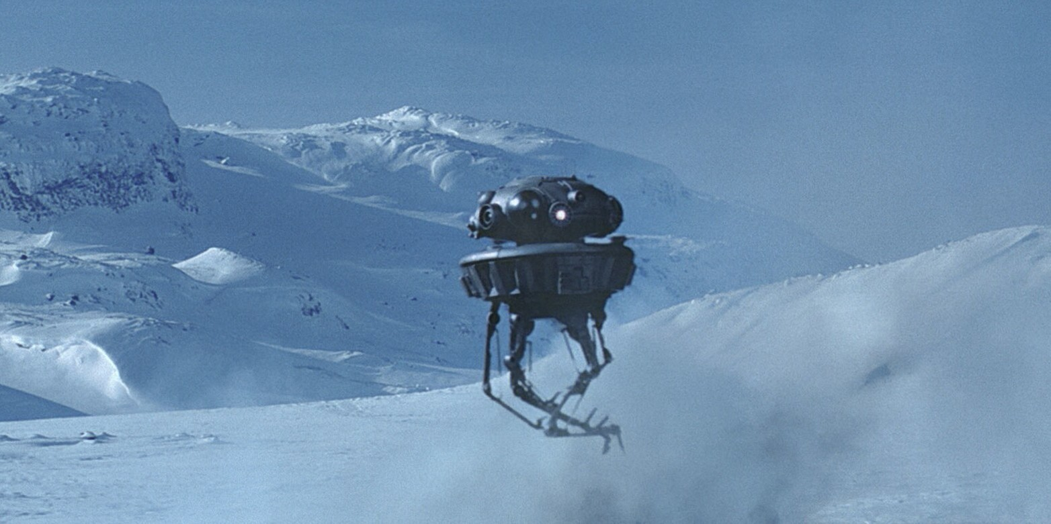

Slide 3

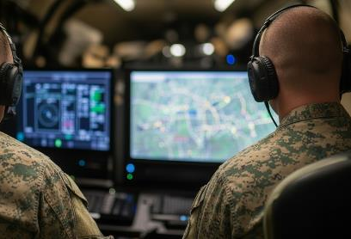
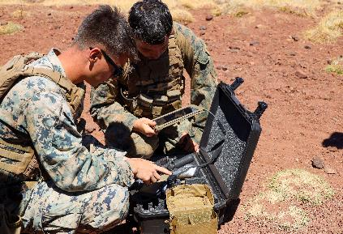
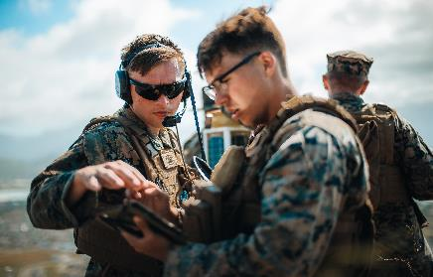
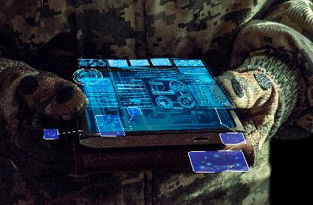
Data as a warfighting asset
Information environment, AI, sensors, and spectrum are shaping the fight now
UNITED STATES MARINE CORPS | DEPUTY COMMANDANT FOR INFORMATION
Sense
Understand
Decide
Act
UNCLASSIFIED | PAGE 3

Slide 4

Data & ai adoption
Trusted, discoverable, usable data across the enterprise
Data cannot remain trapped in silos
Resilient networks are foundational
AI/automation should compress timelines and improve decisions
Technology supports Marines; it does not replace human judgment
UNITED STATES MARINE CORPS | DEPUTY COMMANDANT FOR INFORMATION
UNCLASSIFIED | PAGE 4

Slide 5
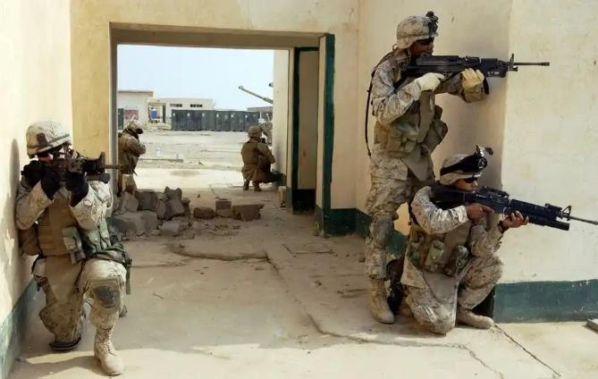
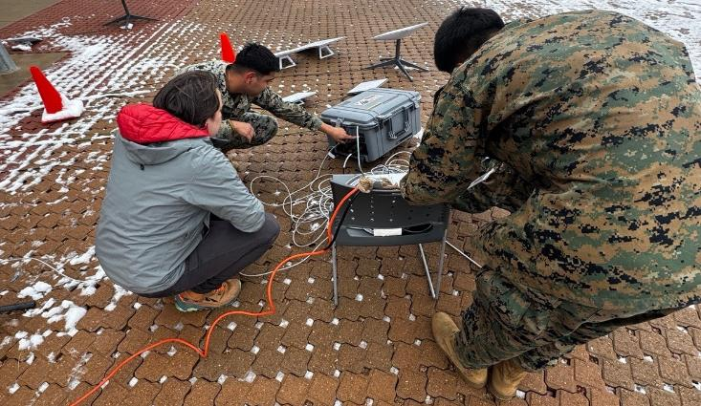
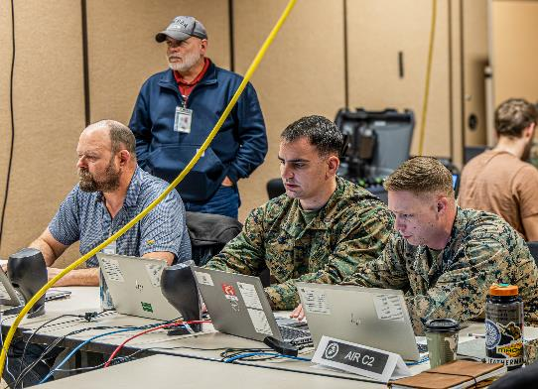
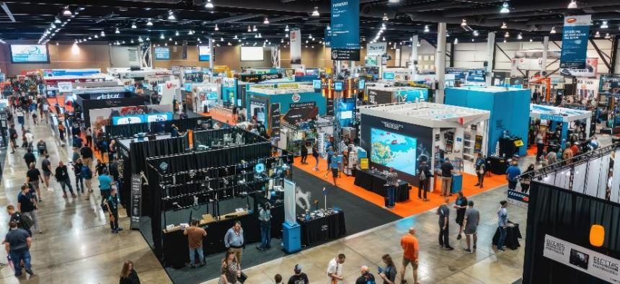
warfighting is a team sport
UNITED STATES MARINE CORPS | DEPUTY COMMANDANT FOR INFORMATION
UNCLASSIFIED | PAGE 5
Notes:
Key Message: We have to budget, program, develop, and design capabilities for the warfighter. Our partnerships with the Joint Force and industry will have to be stronger, more integrated in a high-end fight. Capabilities that are “usable, but obsolete” will lose the war (i.e., we can still defeat a low-end adversary with “usable” capabilities, but not China).
What I ask from industry:
1. Warfighter-centered design:
Technology does not win battles—Marines do. We must design every platform with the warfighter at the center.
Industry designers must meet the Marine, not the other way around. Build a user interface that looks like a cell phone and build a drone controller that looks like a video game controller. Do that, and I can keep our Marines proficient on emerging tech without taking them out of the fight to back to a schoolhouse or spend hours reading a Technical Manual.
2. Fighting with Prototypes:
The last two Commandant have said this. Get technology into the hands of our warfighters and staff enablers early and often.
From concept to delivery, get your engineers out of the labs and into the warfighting world. We have to design smartly, develop quickly, and scale widely.
Affordability:
We cannot afford to replace our hardware across the board right away. We need to modernize legacy platforms through software upgrades.
Adopting hardware-agnostic software is operationally relevant and a budgetary necessity for protracted conflict.
*Story behind bottom left and bottom right photos: Project Dynamis Serial 005 as part of Ivy Sting IV at Fort Carson, CO. Dynamis, II MEF Marines, Navy Carrier Theodore Roosevelt, and Army 4th Infantry Division conducting C2 exercise. Anduril engineers were on hand, problem solving and writing code with Marines. The exercise planners briefed the 4th Infantry Division CG via a stop light chart every evening and every morning. Because industry engineers were working alongside Marines and soldiers, the “red lights” on the stop light chart would become green between briefings.
Similarly at II MEF, Task Force 84.2. MSS engineers and Marines are developing applications that fuse disparate data streams in hours and days. These are not data scientists—they are comm Marines and intel Marines—Captains and Corporals. They are accelerating decision cycles because industry designed and built the environment so that users can inherently adapt it.

Slide 6

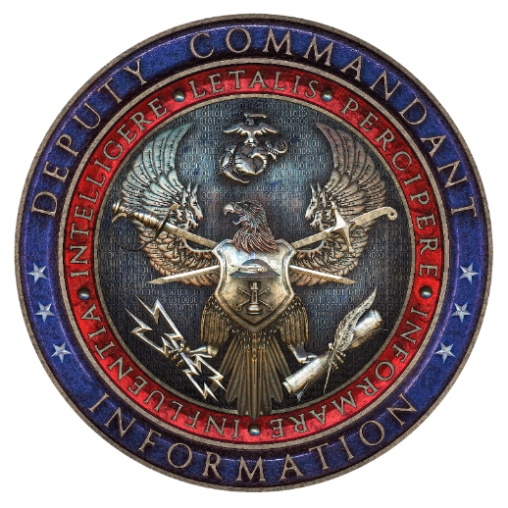
Questions?
UNITED STATES MARINE CORPS | DEPUTY COMMANDANT FOR INFORMATION
UNCLASSIFIED | PAGE 6
Notes:
Messaging from the Administration and DOW is unambiguous… we need to normalize rapid technology adoption and integrate it now.
The historical record shows we’re pretty good at this as Marines:
New amphibious doctrine and landing craft in the interwar years
Pioneering helicopter vertical envelopment.
MAGTF concept in the 1960s to mastering the population-focused small wars and COIN ops in Vietnam and again in Iraq and Afghanistan.
Marines have always evolved to win.
Mastering Information Warfare is central to our latest challenge and is the logical extension of our historical DNA.
Our true strength relies on deep integration with industry partners. We must share threat intelligence, co-develop solutions, and weave your innovations seamlessly into the way Marines actually fight. GOTS and COTS solutions and collaboration will deliver the decisive edge.
Many of you in this room focus on software, and that is exactly where we need to be. We must fully embrace data-centric, software-defined warfare.
Three considerations for software adoption:
Affordability:
We cannot afford to replace our hardware across the board. Need to modernize legacy platforms through software upgrades.
We cannot afford bespoke, vendor-locked solutions. GOTS and COTS must integrate seamlessly.
This optimizes the budget, also supports the Marines who have the muscle memory, reps-and-sets on our existing systems.
Warfighter-centered design:
Technology does not win battles—Marines do. We must design every platform with the warfighter at the center.
Consider this context: retention among our Cyber Marines has hit 100% over the last two years. Why? Because they are "on mission" every single day.
If we pull Marines out of the fight to sit in garrison, click through online training, or go back to a schoolhouse just to learn a clunky new platform, we will lose them.
Fighting with Prototypes:
The challenge is keeping our Marines proficient on emerging tech without taking them out of the fight.
The Marine Corps is all-in on this approach, just as the Commandant has directed for years. We must get technology into the hands of our warfighters and staff enablers early and often.

