Slide 1
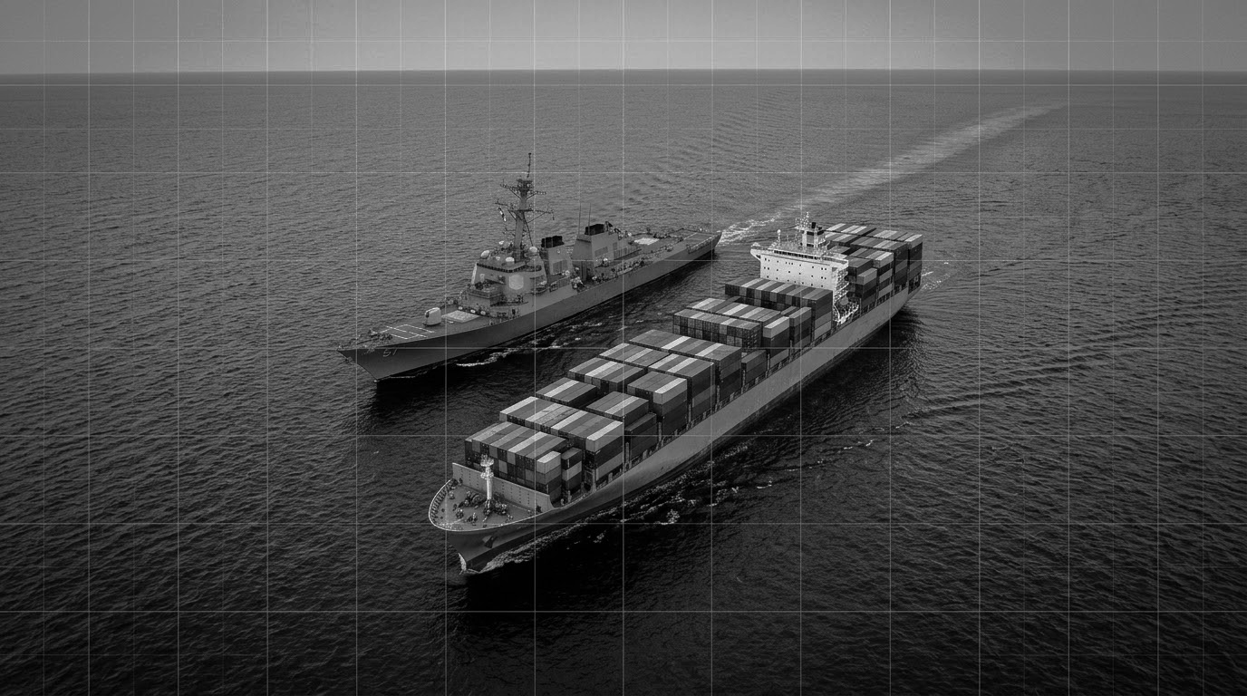

Maritime & Logistics Intelligence
Michelle Brouhard
Head of Policy and Geopolitical Risk
Prepared for:
Prepared by: Kpler

Slide 2
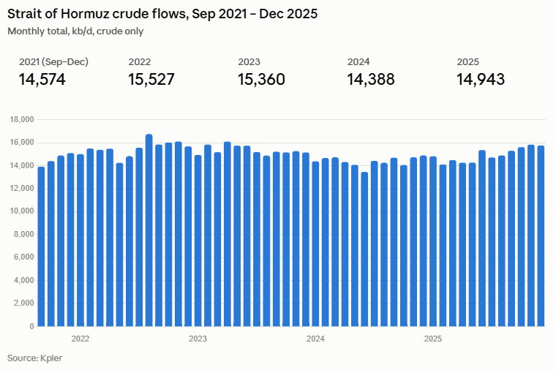

2

Slide 3
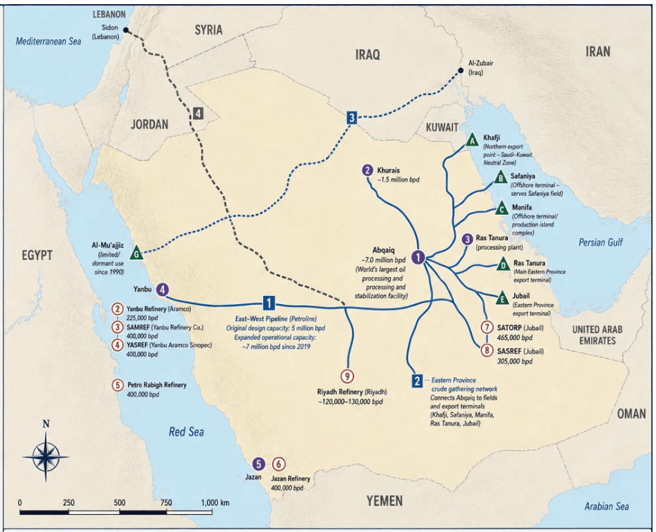
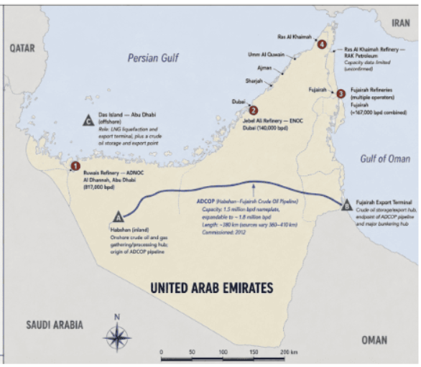
Saudi’s can reroute approx 4 mm b/d
The UAE can reroute approx 2 mm b/d
2

Slide 4
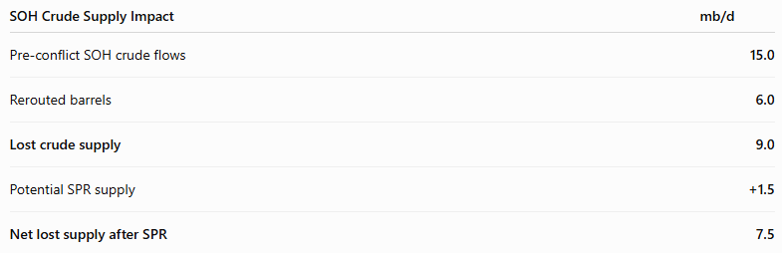
Bridging the Gap on the Strait of Hormuz
IEA SPR release was announced on March 11 and the US had deliveries the week after.
2

Slide 5
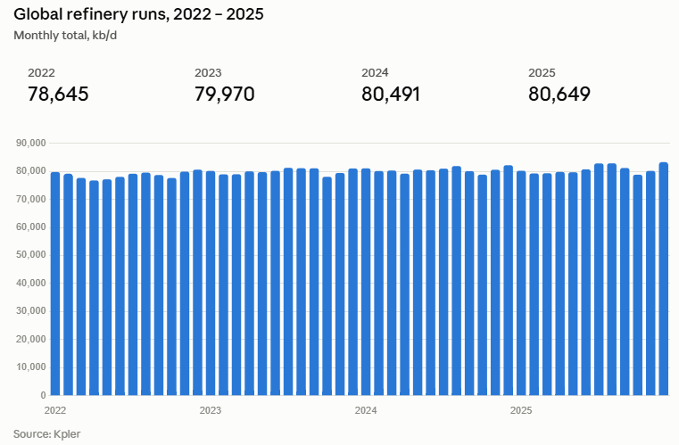
2

Slide 6
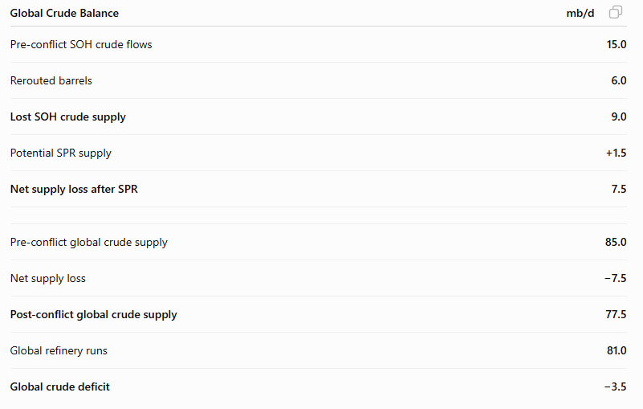
The Global Supply and Demand Picture
2

Slide 7
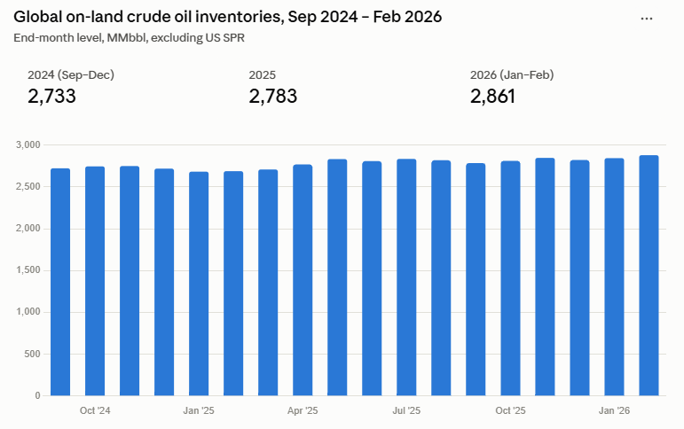
2

Slide 8
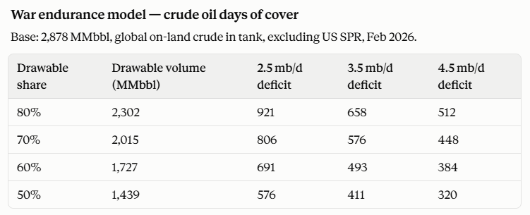
2

Slide 9
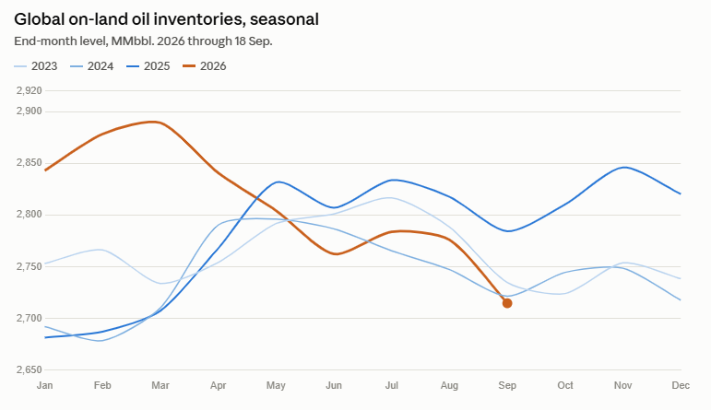
2

Slide 10
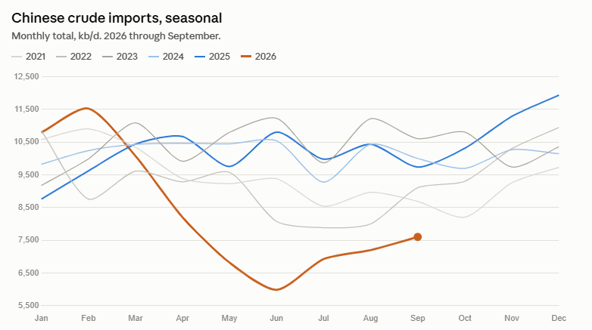
2

Slide 11
defense@kpler.com
www.kpler.com

