Slide 1


CJADC2: The Future of Joint Multi-Domain Operations
Strengthening Information Dominance & Interoperability
Ms. Laura Guay
USAF ACC AI Technical Director
CDAO Defense & Security
16 September 2025

Slide 2
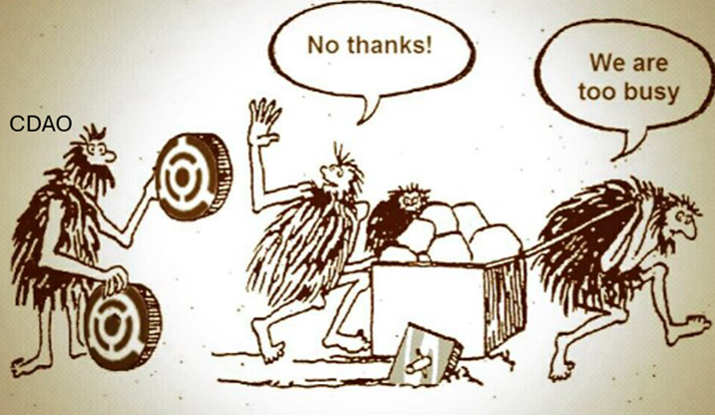

Slide 3




Introduction
Interconnected Battlefield
Paradigm Shift
Real-time decisions across domains
Digital landscape demands innovative solutions
Critical Technologies
Generative AI and enterprise analytics ensure mission success

Slide 4

Challenges in Multi-Domain Operations
Interoperability Issues
Disjointed systems hinder collaboration with non-NATO allies
Compromised Awareness
Connectivity gaps reduce clear battlespace picture
Delayed Intelligence
Slow data sharing impacts timely decisions
Disrupted Planning
Incompatible systems weaken cohesion

Slide 5





Solutions Enabled by CJADC2
Actionable Intelligence
Palantir and Anduril Lattice aggregate data for rapid insights
Real-Time Analysis
AWS SageMaker and HawkEye 360 enhance situational awareness
Sentiment Analysis
Ask Sage and Azure analyze foreign communications
Secure AI Platforms
Mission-critical capabilities for multimodal analysis

Slide 6
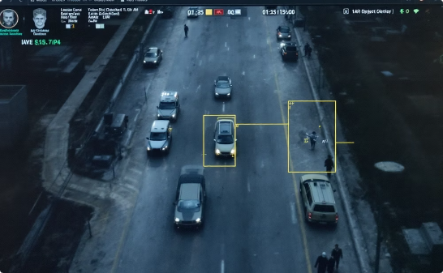


Case Studies of AI in Military Operations
Project Maven
Ask Sage
Ukraine's Drone Innovation
Automates object detection in drone feeds, enhancing intelligence analysis and scalability across platforms
Real-time sentiment analysis, translation and decision support at IL5 and FedRAMP High
Rapid innovation and adaptation with
AI-driven systems producing mission-
specific drones

Slide 7








Lessons in Interoperability
Allied Collaboration
Common standards prevent operational friction
Framework Recommendations
Dynamic frameworks for safe AI deployment
Technical Challenges
Address explainability and training data sensitivity
Interoperability Priority
Seamless communication critical for coalition warfare

Slide 8










Benefits and Impact of CJADC2
Accuracy
Speed
Reduced human error strengthens intelligence confidence
Faster decisions ensure tactical advantage
Collaboration
Breaking bottlenecks fosters cross-domain cohesion
Decision Advantage
Real-time insights dominate decision cycle
Resilience
Secure systems ensure continuity in contested environments

Slide 9

Call to Action
Invest in Emerging Technologies
Prioritize AI, edge computing, advanced analytics
Streamline Procurement
Reduce barriers to cutting-edge solutions
Foster Collaboration
Strengthen joint force, ally, academia, industry partnerships
Cultivate Expertise
Train personnel to leverage AI technologies

Slide 10



Conclusion
Future of Operations
Information dominance and interoperability as cornerstones
Integration
Advanced technologies foster swift adaptation
Time to Act
Embrace CJADC2 for enduring decision advantage

Slide 11
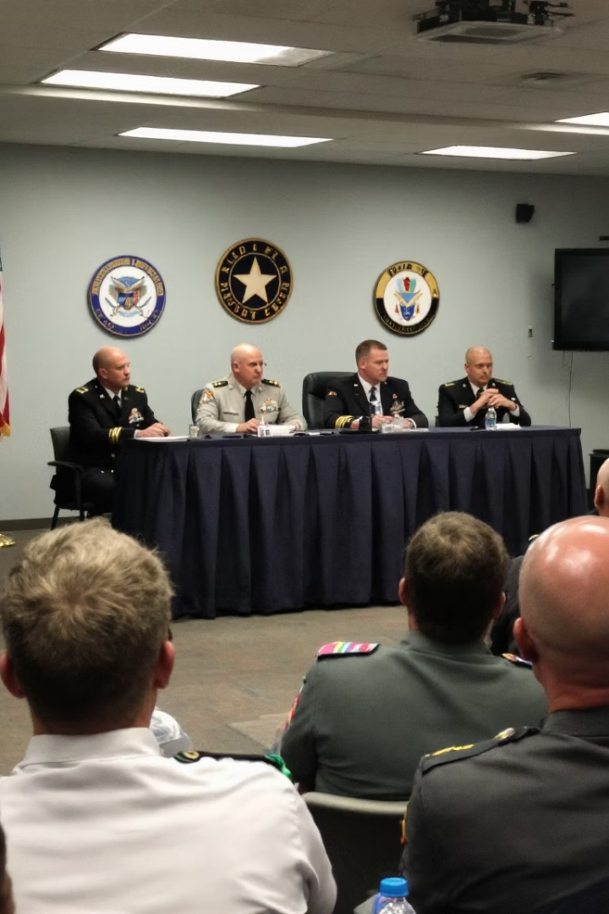
Questions and Discussion
Thank you for your attention!
5
24/7
Domains
Operations
Integrated across air, land, sea, space, cyber
Continuous decision advantage
100%
Commitment
Full dedication to information dominance

