Slide 1
Accelerating Autonomy:
Innovation Pathways from Lab to Lethality
UNCLASSIFIED
Dr. Matt Willis – Director, Army FUZE
UNCLASSIFIED
September 2025

Slide 2



The Urgency of Now
UNCLASSIFIED
Demand Signals
Army Innovation Response
Competitive Edge
Army FUZE
The Army faces accelerating competition from near-peer adversaries, who are investing aggressively in AI, autonomy, hypersonic, and other disruptive technologies – these investments are being translated rapidly into fielded capabilities
As the Army’s unified innovation portfolio, FUZE scans widely for emerging technologies, invests early in high-potential solutions, takes calculated risks to accelerate development, and scales what works - transforming internal demands and external pressures into a reliable pipeline of mission-ready capabilities aligned with modernization priorities
Rapid Acquisition
Traditional acquisition timelines are not sufficient to keep pace. To maintain overmatch the Army must adopt new models of innovation that shorten development cycles, reduce risk, and accelerate the delivery of technologies into the hands of Soldiers
Market-Driven Innovation
Many of the technologies that will define future warfare are being developed outside of the defense sector, primarily in commercial markets such as energy, robotics, data analytics, and biotechnology
UNCLASSIFIED

Slide 3
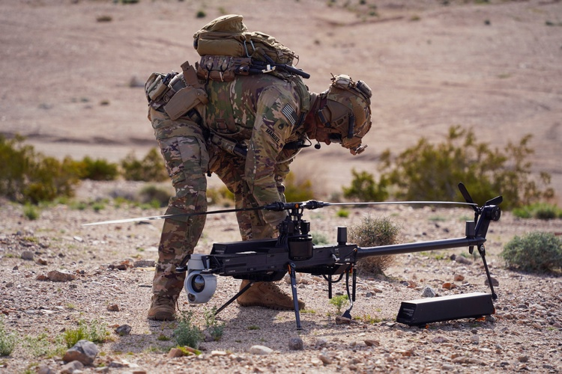
The Role of Autonomy in Army Modernization
UNCLASSIFIED
Why Autonomy?
Tactical Edge Superiority: Autonomous systems enable faster decision cycles in denied environments.
Force Multiplication: One Soldier can control multiple assets, increasing operational reach.
Speed to Mission Execution: Autonomy shifts the battlefield tempo – giving us first-mover advantage.
“Autonomy isn’t about replacing Soldiers – it’s about empowering them to dominate complex battlespaces.”
U.S. Army Staff Sgt. Stetson Manuel, a Robotics and Autonomous Systems platoon sergeant and infantryman, assigned to the Alpha Company, 1st Battalion, 29th Infantry Regiment, 316th Cavalry Brigade, assembles the Ghost-X Unmanned Aircraft System during the human machine integration experiment for Project Convergence – Capstone 4 in Fort Irwin, Calif., March 11, 2024.
UNCLASSIFIED

Slide 4




Army FUZE Portfolio
UNCLASSIFIED
Expanding the Industrial Base
Driving Dual-Use Investments
xTech
Sbir|sttr
xTech is the Army’s top prize competition for scouting and advancing dual-use innovation.
Open-topic challenges engage startups, academics, and commercial firms, offering cash prizes, Army exposure, and transition paths. xTech connects emerging tech with military needs through a
low-barrier, high-visibility platform.
The Army SBIR|STTR Program connects small businesses with non-dilutive funding, expert support, and Army stakeholders to develop
dual-use tech for mission needs. SBIR|STTR turns early-stage ideas into operational solutions, driving modernization and strengthening the industrial base.
FUZE
Manufacturing at Scale and Speed
Bridging the Valley of Death
mantech
Tmi
The Army Manufacturing Technology (ManTech) Program strengthens the industrial base by making defense technologies producible, scalable, and sustainable. ManTech invests in advanced manufacturing, materials innovation, and supply chain resilience to transition new capabilities into affordable, resilient full-rate production.
The Technology Maturation Initiative (TMI) bridges innovation with battlefield integration - accelerating transition by validating performance, reducing risk, and aligning with mission needs. TMI works with innovators, acquisition teams, and end users to test and refine technologies in realistic environments, ensuring they’re ready and relevant.
UNCLASSIFIED

Slide 5
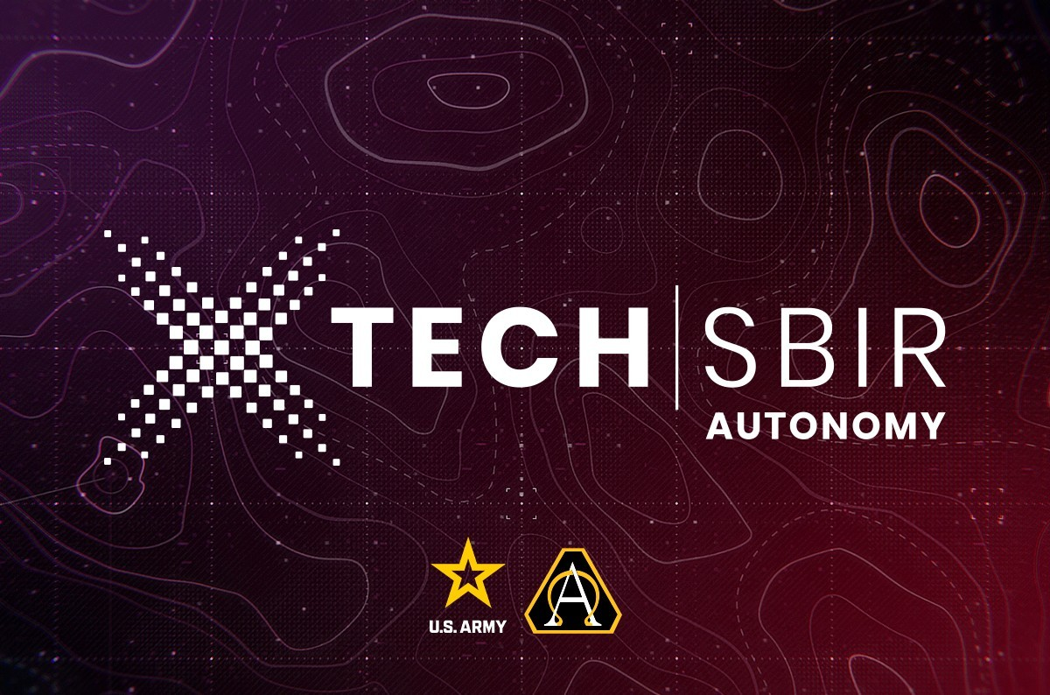



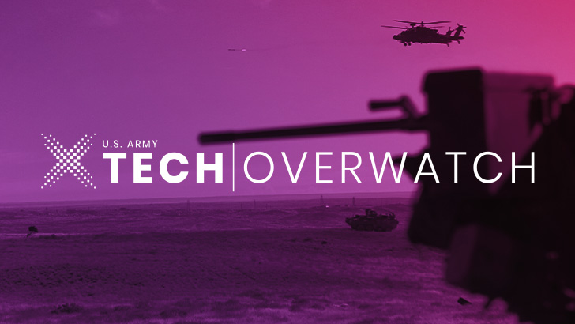



FUZE in Action: xTech SBIR Autonomy Competitions
UNCLASSIFIED
U.S. small businesses were invited to submit autonomous ground and air technologies that enhance Army capabilities in complex, contested environments - focusing on mobility, survivability, low-profile design, rapid training, reprogrammable systems, advanced sensing, and reduced logistics.
Small businesses across the U.S. were welcome to submit innovative concepts for an advanced autonomous unmanned system (UAV, UGV, and/or sensor network)
UNCLASSIFIED

Slide 6
A Strategic Pipeline for Innovation
UNCLASSIFIED
By proactively identifying and addressing key pain points, the Army has evolved into a more agile and attractive business partner. Targeted initiatives include:
Understanding how a startup’s “funding runway” constrains its ability to navigate a long award process
Reducing operational complexity and barriers to entry to enhance experience for internal and external stakeholders
Improving access to Army people, problems and data, while reducing restrictive requirements
Ensuring partnerships are a steppingstone to transition to Army Programs of Record and further funding/integration
Delivering quickly on FUZE strengths to posture technologies for rapid transitioning to warfighter capabilities
Releasing projects to better reflect how technology challenges manifest within the Army and create multiple entry points for companies (vice yearly solicitation)
Advertising programs effectively to small businesses, and having an attractive offer ready to raise odds of partnership
Standing up an Army FUZE Contracting Center of Excellence dedicated to ever-improving and expediting the contracting experience
UNCLASSIFIED

Slide 7




Pathways to Partnership
UNCLASSIFIED
Co-Designing the Future Force
Accelerating Field-Ready Innovation
Navigating the Transition Gap
Unlocking Dual-Use Impact
FUZE invites partners to build alongside Soldiers, not just for them.
By embedding end-user feedback early, solutions are shaped by operational realities, not assumptions.
FUZE enables fast, iterative testing in live environments. Partners gain access to Soldier insights, real-world constraints, and the ability to pivot quickly toward mission-ready solutions.
FUZE helps bridge the notorious “valley of death” by aligning tech with Army priorities, validating use cases, and transitioning solutions into programs of record.
FUZE identifies and adapts commercial innovations for military use, enabling companies to expand into defense without losing their core market focus.
Ideal for: Innovators, startups, and technologists
Ideal for: Agile developers and rapid prototyping teams
Ideal for: Researchers and ventures stuck between R&D and acquisition
Ideal for: Commercial tech companies with defense potential
UNCLASSIFIED

