Slide 1
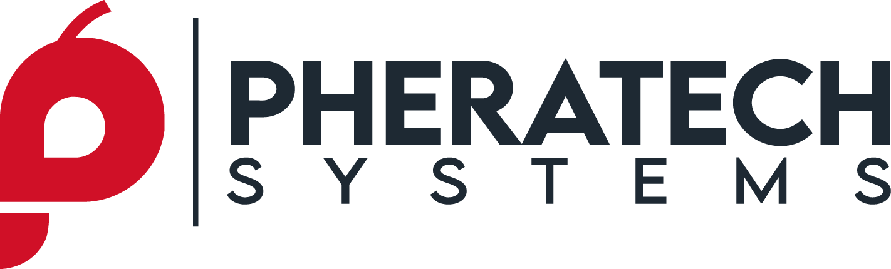
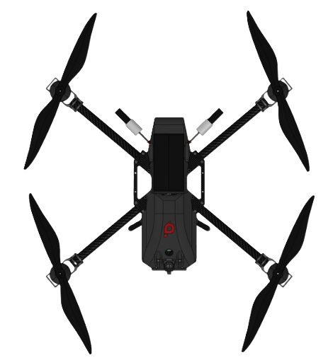
Pheratech Systems Inc.
From Innovation to Deployment: Delivering AI-Enabled Capabilities for Defense Missions
Michael Huynh – Founder & CEO
CDAO Defense and Security
September 22, 2026
All content proprietary & confidential | Copyright © 2026 Pheratech Systems Inc. All Rights Reserved.
Notes:
Much of this conference speaks to how we turn data into better decisions and how we can help commanders make faster decisions. Our work is primarily in the robotics space: once information arrives, which systems should act, and how does a team of robots coordinate with connectivity changes? Today I’ll walk through what we’re building, the elements tested at Camp Shelby, and what we’re learning about the path to deployment.

Slide 2
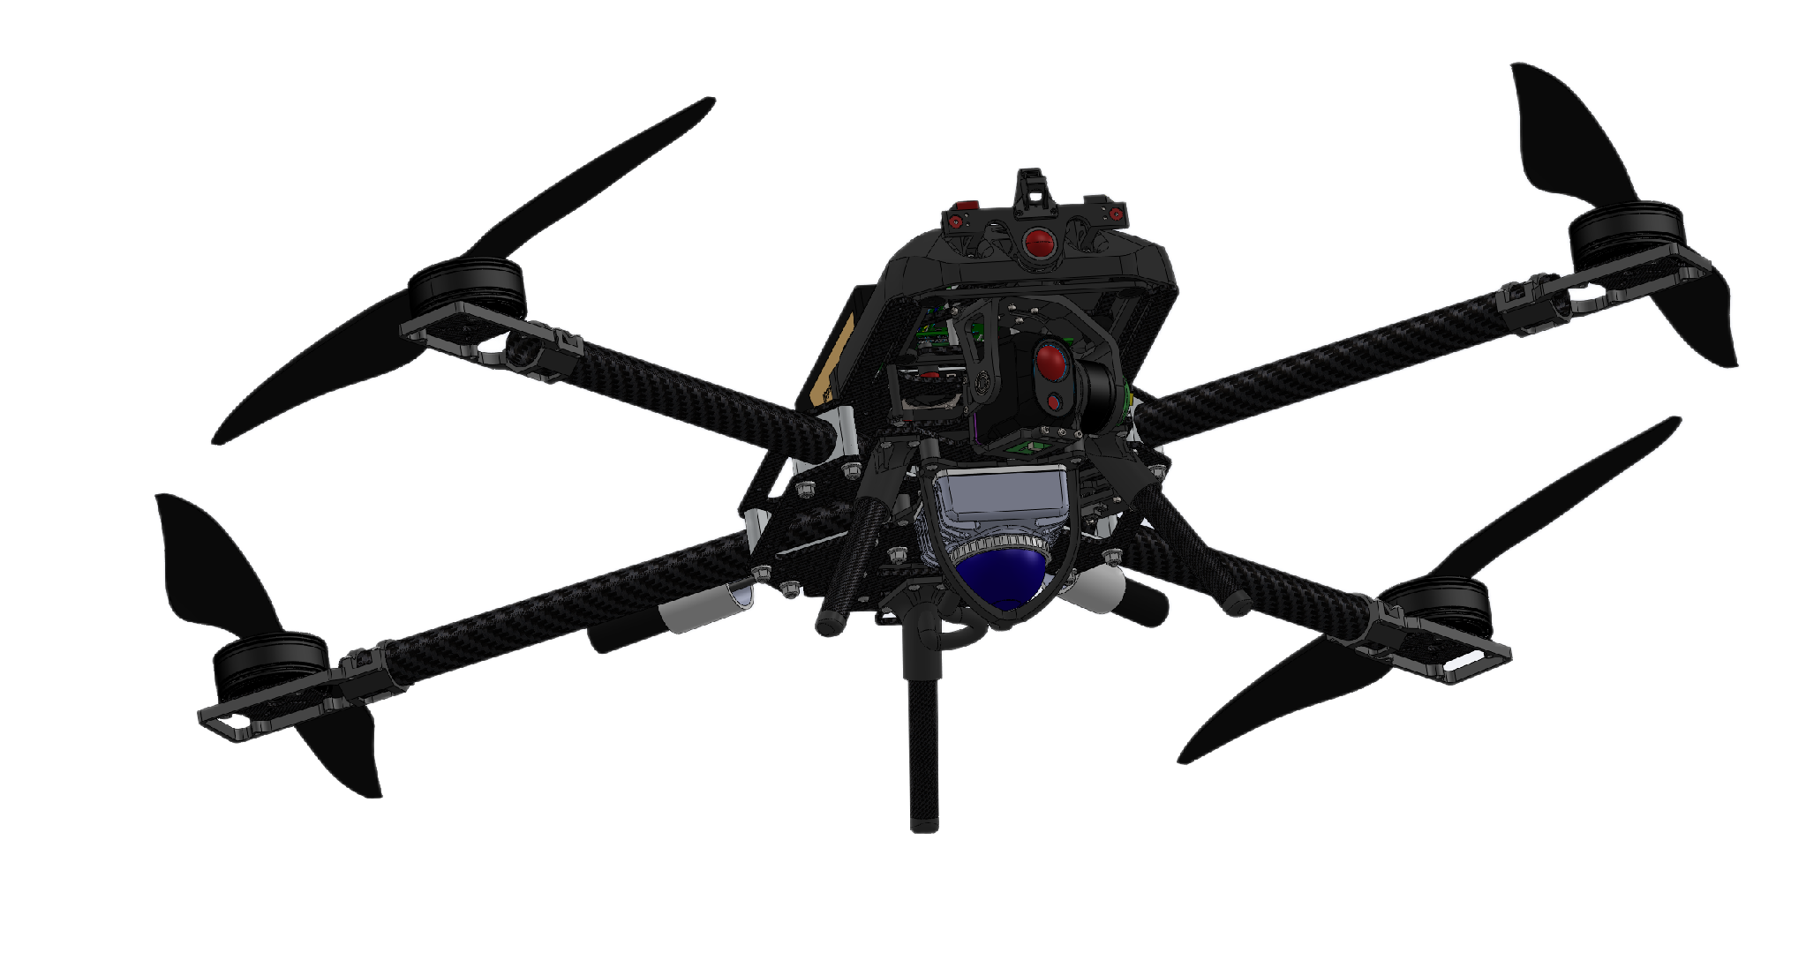
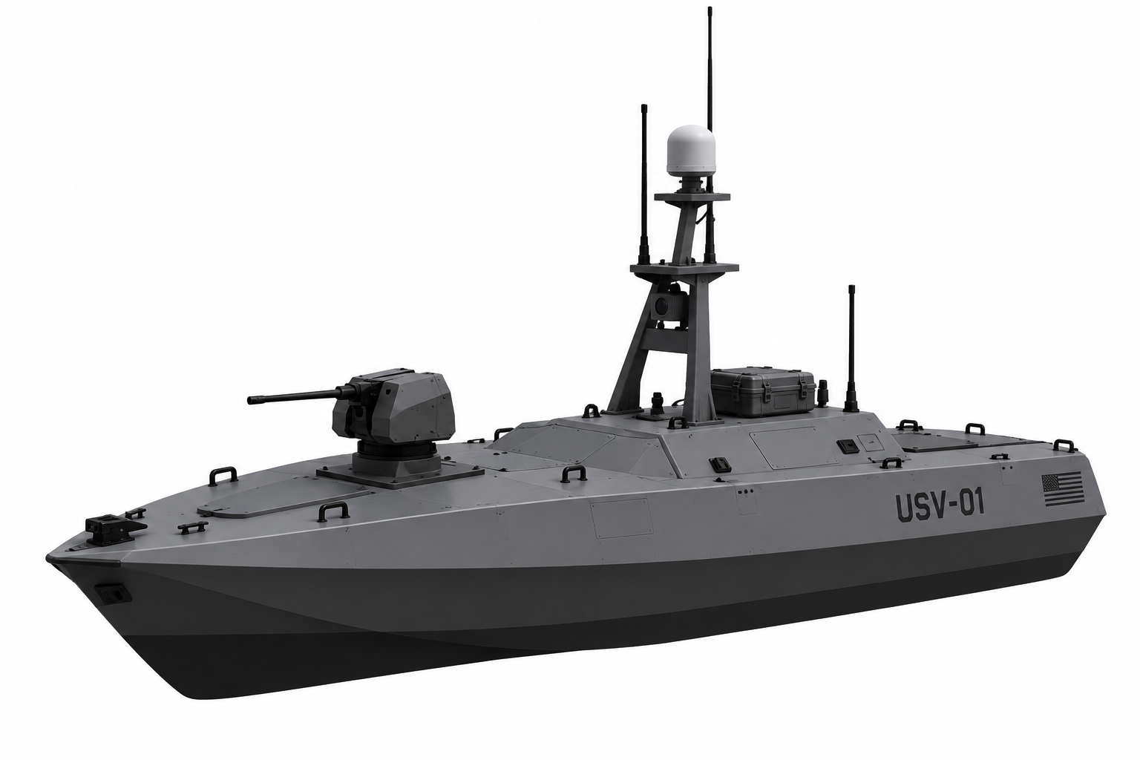
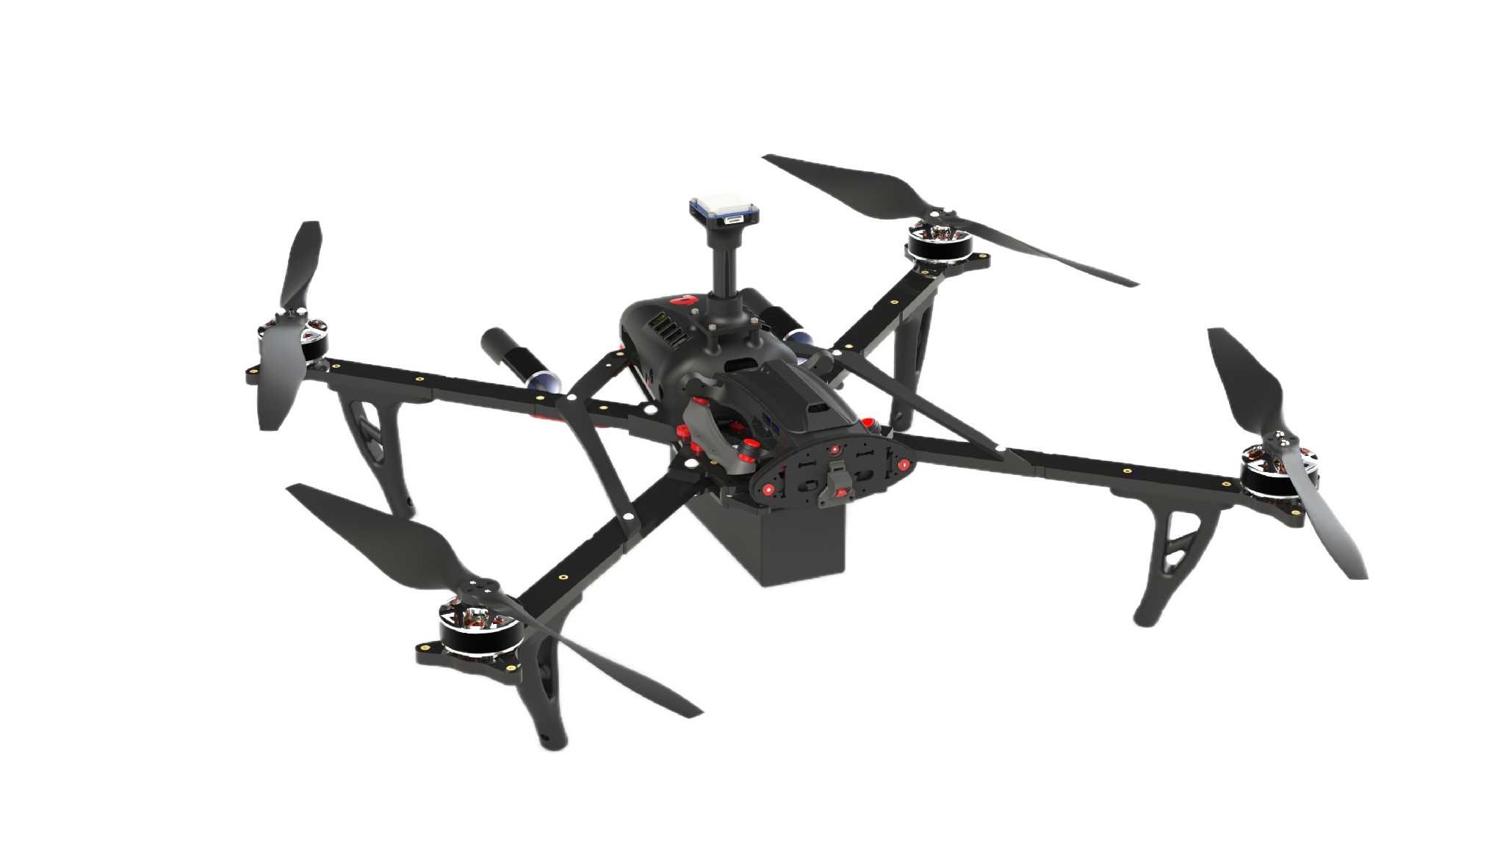
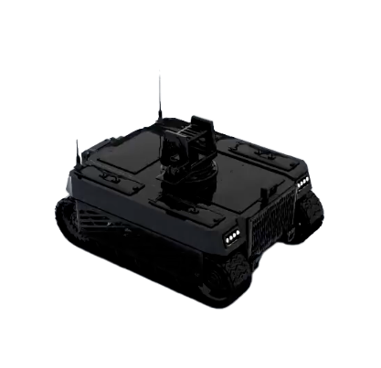
Pheratech Systems Intro
Pheratech Systems Inc.
Unmanned Surface Vehicle (USV)
We build software that enables different robotic systems to coordinate as a team.
Concord
Our coordination software connects mission intent with task allocation across robots.
Robotic platforms
We also develop small unmanned aircraft and use our hardware to test capabilities in the field.
Unmanned Aerial System (UAS) – Overwatch/ISR Variant
Unmanned Aerial System (UAS) – Strike/Payload Variant
Unmanned Ground System (UGV)
All content proprietary & confidential | Copyright © 2026 Pheratech Systems Inc. All Rights Reserved.
Notes:
We’re Pheratech Systems. We build coordination software for teams of robots, alongside building small unmanned aircraft. Our work addresses a practical question: how do different systems divide the work and adapt as conditions change?

Slide 3
Sharing Data and Work
Pheratech Systems Inc.
Sharing Data | Sharing Work
What was observed? Where and when? How reliable is the information? | Which systems can act? Who does the task? How does the team adapt when conditions go awry?
All content proprietary & confidential | Copyright © 2026 Pheratech Systems Inc. All Rights Reserved.
Notes:
The reason we’re building Concord is that getting robots to exchange information is only part of getting them to work together.
Imagine an aerial scout detects something that needs a closer look. It shares the location, a timestamp, and its confidence in the observation. Other systems can now receive that information. But the team still has a decision to make: who should investigate?
The closest platform might not have the right sensor. Another might have the sensor but insufficient battery. A third might already be performing a task that matters more. So the decision depends on both what was observed and what the available systems can actually do.
Then someone needs to take responsibility. Otherwise, multiple platforms might duplicate the same work, or each might assume another is handling it.
And that assignment has to change with the situation. If the selected vehicle becomes unavailable, who takes over? If it loses contact, is it still executing its task? When communications return, how does the team reconcile what happened?
That’s what we mean by sharing work: using information about the environment and the team to allocate responsibility, then adapting those assignments as conditions change.
This is the coordination problem we’re addressing with Concord. It becomes especially challenging when the team includes different platforms, built by different vendors, with different capabilities.

Slide 4
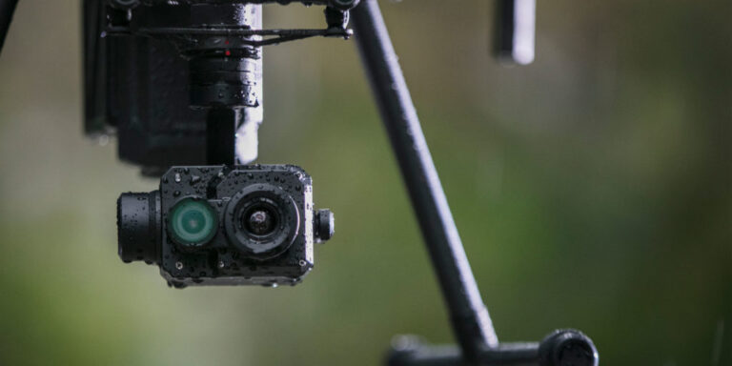
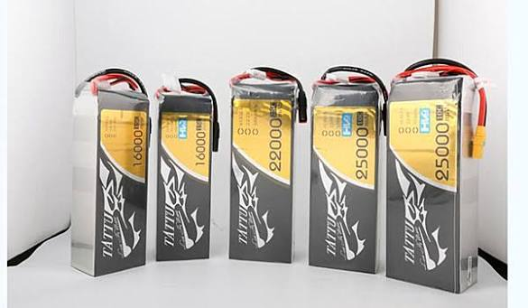
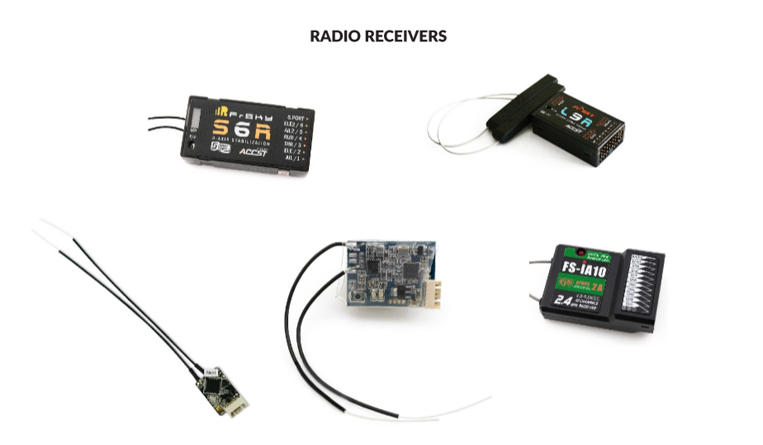
Different Systems, Different Capabilities
Pheratech Systems Inc.
Each platform brings its own sensors, software, and operating limits.
Capabilities: What it can sense and do.
Availability: Battery, payload, connectivity, and current assignments.
Interfaces: Different autonomy stacks and data formats.
Coordination must account for those differences as conditions change.
All content proprietary & confidential | Copyright © 2026 Pheratech Systems Inc. All Rights Reserved.
Notes:
Those assignment decisions get harder because the systems aren’t interchangeable.
An aircraft can reach an area quickly, but it has limited endurance. A ground vehicle may carry a different sensor and remain on station longer, but it can’t necessarily reach the same locations. Even two aircraft may have different payloads, onboard computers, and software.
And capability changes during the mission. A vehicle that was the best choice ten minutes ago may now have too little battery or be committed elsewhere.
Our approach is to work with that diversity. We need a way to represent what each platform can do, what it has available right now, and which tasks it can accept.
There’s also an integration challenge. Each platform exposes information and accepts commands differently. The host software connects those interfaces to Concord, which uses the normalized information to coordinate tasks.
That’s the role Concord is designed to fill: coordinating across the capabilities available, while each platform’s existing software handles vehicle execution.

Slide 5
Building Concord
Pheratech Systems Inc.
Coordination software for teams of different robots.
Capability awareness: Accounts for what each teammate can do and its current availability.
Task allocation: Divides work across available platforms and adapts assignments.
Human supervision: Operators provide mission intent through ATAK or Pheratech GCS.
Coordination runs onboard each vehicle.
All content proprietary & confidential | Copyright © 2026 Pheratech Systems Inc. All Rights Reserved.
Notes:
That brings us to Concord, our coordination software for teams of different robots.
Concord uses information about each platform’s capabilities and current availability to help divide the work. What sensors does it carry? Does it have enough endurance? Is it already committed to another task?
Those answers matter because the best assignment changes throughout a mission. A platform may become unavailable, a new observation may create another task, or the team may need to reprioritize its work.
The operator provides mission intent through ATAK or our ground control station and supervises execution. Our goal is to reduce how often that operator has to manage individual assignments as conditions change.
Coordination runs onboard each vehicle. That means we have to account for incomplete information and changing connectivity, including uncertainty about what teammates are still doing when contact is lost.
That’s Concord’s role. The next question is how we connect it to the software already running on those platforms.

Slide 6
Integrating Concord
Pheratech Systems Inc.
Command and Control (C2) Software
Concord connects mission intent with coordinated robot behavior.
Command and control: Operators define objectives and supervise the mission.
Concord: Allocates tasks across available platforms and adapts assignments as conditions change.
Vehicle autonomy: Existing software executes assignments and manages vehicle control, sensors, and networking.
Integrates with existing autonomy through ConcordSDK.
Tactics and Intent Translation Software
Pheratech’s Concord (ConcordSDK)
Robot Onboard Autonomy / Host Runtime
All content proprietary & confidential | Copyright © 2026 Pheratech Systems Inc. All Rights Reserved.
Notes:
This diagram shows the division of responsibilities.
At the top, command-and-control software gives the operator a way to establish objectives and supervise the mission. The intent translation layer turns that direction into tasks the coordination layer can work with.
Concord allocates those tasks across the available platforms. Each vehicle’s existing autonomy software then handles execution, including movement, sensor operation, and vehicle control.
For an integration partner, the connection is ConcordSDK. Their host runtime supplies telemetry and peer messages to the SDK, then executes the task assignments it returns.
For example, Concord might assign a platform to inspect a location. The platform’s own software determines how to navigate there and operate its sensors. That lets us connect coordination to different vehicle stacks while preserving their platform-specific responsibilities.
One detail about this diagram: the vertical stack shows software responsibilities. It doesn’t represent a single central computer directing the fleet. Concord runs onboard the participating vehicles.
Let’s make that concrete with a support mission involving several platforms.

Slide 7
Coordinating Support Mission
Pheratech Systems Inc.
The Sequence (Illustrated Sequence to be Tested):
Detect: An aerial scout identifies a location needing support.
Establish overwatch: An overwatch aircraft launches to monitor the area via thermal vision.
Deliver supplies: A payload aircraft launches to deliver first aid or logistics supplies.
Provide ground support: A ground vehicle moves to the location for follow-on assistance.
Concord coordinates task assignments as mission needs and platform availability change.
All content proprietary & confidential | Copyright © 2026 Pheratech Systems Inc. All Rights Reserved.
Notes:
Consider a support mission involving four platforms with different roles.
An aerial scout identifies a person or location needing assistance and shares the observation. That information creates several related tasks.
An overwatch aircraft launches to maintain visibility of the area and provide updated observations. A payload aircraft delivers first-aid or logistics supplies. A ground vehicle then moves in to provide follow-on support.
The coordination challenge is deciding which available platforms can perform those tasks and how their assignments depend on each other. The payload aircraft needs the delivery location. The ground vehicle needs updated information as it approaches. If a platform becomes unavailable, the team needs to determine which work can continue and which assignments need to change.
That is the distinction between sharing data and sharing work. The initial observation becomes a set of coordinated responsibilities across different systems, while the operator supervises the mission.
This sequence illustrates the overall concept. At Camp Shelby, the team tested specific elements of Concord, which I’ll cover next.

Slide 8
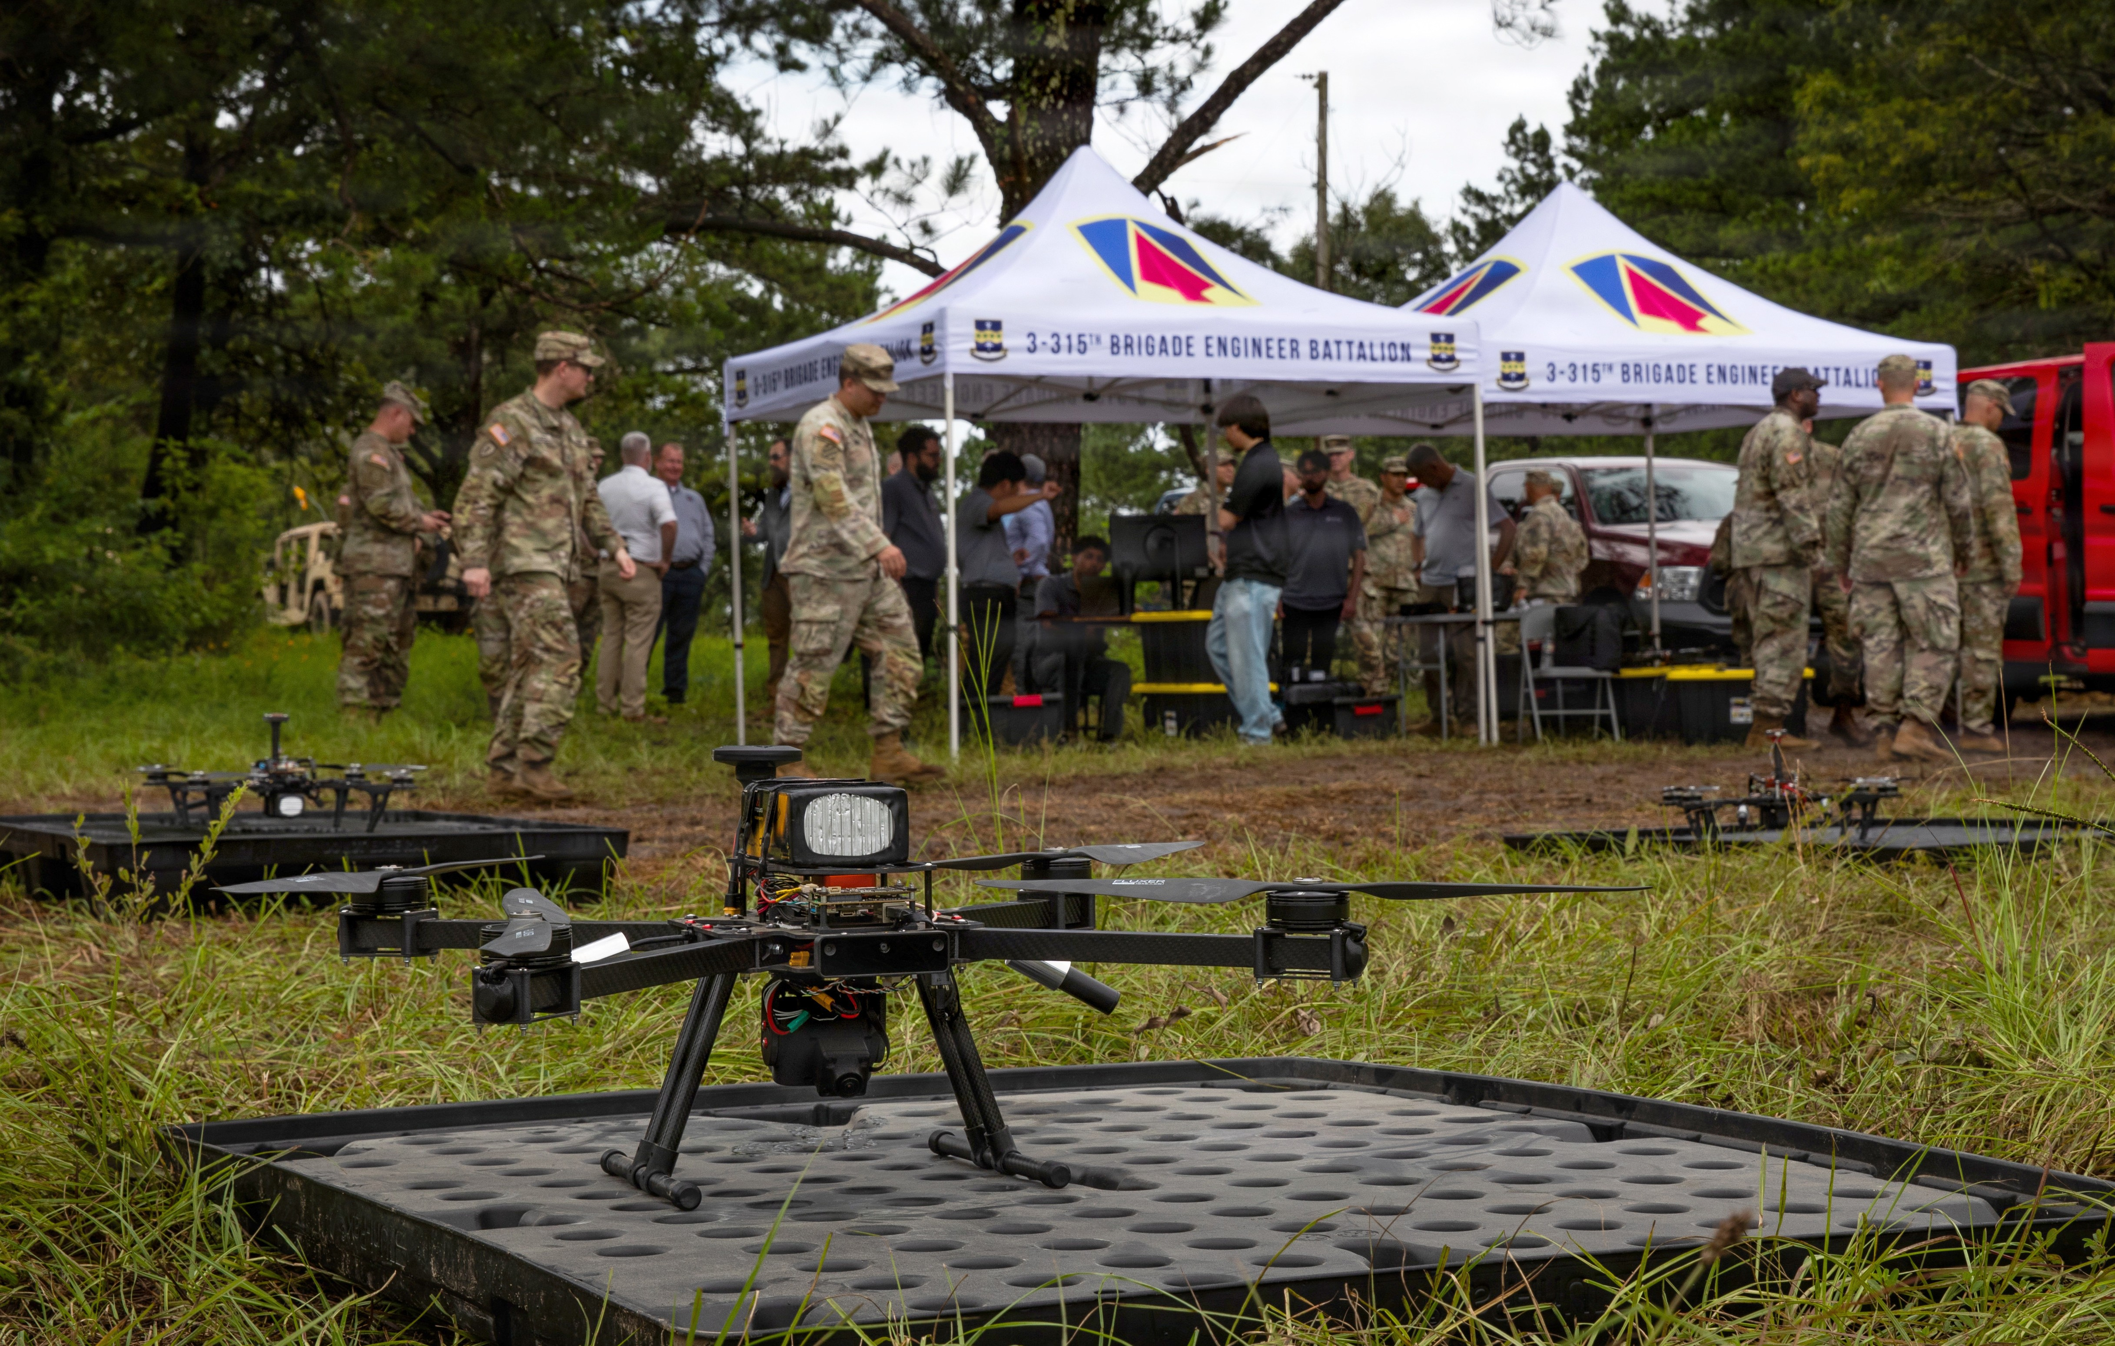
Camp Shelby
Pheratech Systems Inc.
In June, The 177th Brigade (1st Army) tested elements of Concord on Pheratech platforms.
Testing focus
Group behavior and operator interaction with multiple group 1 UAS.
Questions for deployment
How consistently does the group respond? When does the operator need to intervene? How do we make it easier for the operator?
Next validation step
Evaluate task allocation across platforms with different capabilities.
All content proprietary & confidential | Copyright © 2026 Pheratech Systems Inc. All Rights Reserved.
Notes:
At Camp Shelby, the 177th Brigade tested general swarm-control behaviors on our platforms, exercising elements of Concord.
This testing covered a narrower scope than the support mission I just described. It focused on controlling aircraft as a group, providing an early step toward the broader coordination capability.
The questions we need to answer as we progress are practical: how consistently does the group respond, how much intervention does the operator need to provide, and how does behavior change when conditions change?
The next validation step we’re proposing is to move from group control into allocating different tasks across platforms with different capabilities. That is how we connect this early testing to the larger mission concept.

Slide 9
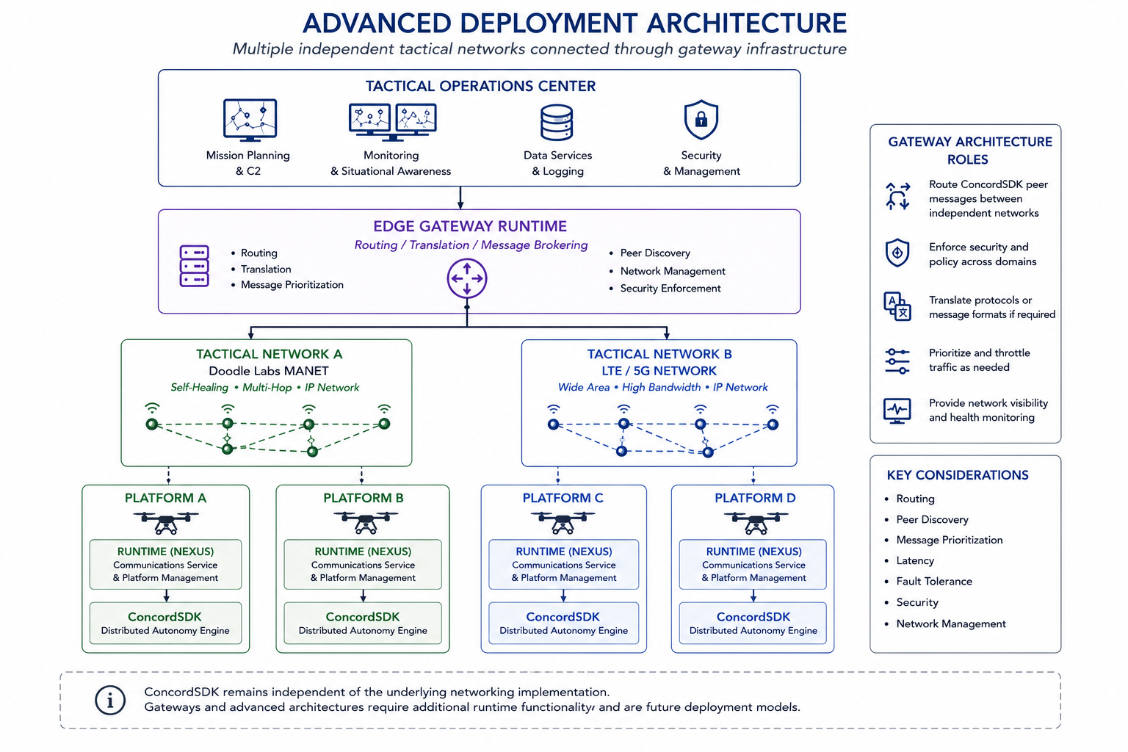
Roadmap
Pheratech Systems Inc.
Broaden integration
Connect additional platforms with different sensors, autonomy stacks, and capabilities.
Validate coordinated missions
Evaluate task allocation and reassignment under changing connectivity and platform availability.
Measure operational value
Track mission completion, operator interventions, and recovery from disruption.
All content proprietary & confidential | Copyright © 2026 Pheratech Systems Inc. All Rights Reserved.
Notes:
Camp Shelby gives us a starting point with testing of general swarm-control behaviors. The broader mission example requires us to extend that evidence.
First, integration across different platforms. Each system needs to provide usable information about its capabilities and status, and reliably execute the assignments it receives.
Second, mission-level evaluation. We need to examine what happens when platforms have different responsibilities, when one becomes unavailable, and when communications are interrupted. That includes understanding when the team can continue and when it needs the operator.
Finally, we need to measure whether coordination delivers operational value. How much work does the team complete? How often does a person need to intervene? How long does recovery take after a disruption?
Those are the measures I would use to connect technical progress to deployment readiness.

Slide 10
Thank You! Questions?
Pheratech Systems Inc.
Michael Huynh
Chief Executive Officer
mhuynh@pheratech.com
Ayodeji Coker, Ph.D.
VP Tech Integration and Transition
acoker@pheratech.com
All content proprietary & confidential | Copyright © 2026 Pheratech Systems Inc. All Rights Reserved.

