Slide 1



SPACEWERX / CDAO DEFENSE & SECURITY 2026
FROM POSSIBILITY
TO ADVANTAGE
Building the conditions for useful space capability to reach the mission.
CHARLENE JACKA
Notes:
SpaceWERX is the innovation arm of the USSF.
Not the integration arm.
This distinction matters because it means that we have to consider the mission owners ability to absorb the capability into the systems, workflows, training, acquisition pathways, and decisions that already matter.

Slide 2
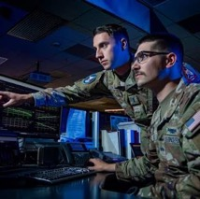







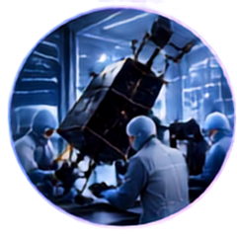


Different Missions. Stronger Together.
Connecting people, ideas, and capability for impact.
OPERATORS & MISSION OWNERS
COMMERCIAL COMPANIES
& NONTRADITIONAL VENDORS
PEOPLE
PROGRAM OFFICES & ACQUISITION PROFESSIONALS
PROBLEMS
POSSIBILITIES
TEST ORGANIZATIONS
& TECHNICAL EXPERTS
PATHWAYS
SENIOR DECISION-MAKERS
Notes:
The CDAO role was established by the National Defense Authorization Act for Fiscal Year 2023 and stood up in September of that year.
The charge is straightforward: ensure that digital technologies and artificial intelligence capabilities meet the needs of the combatant commands and the broader defense enterprise.
That requires coordination across military organizations and partner agencies.
It also requires a connection between the mission problem, the technology, and the organization that will eventually use and sustain the capability.
That is where SpaceWERX fits.
We are the innovation arm—not the integration arm.
Our role is to help identify important operational problems, bring in the right commercial and research partners, create evidence, and help establish a credible path toward transition.
The receiving organization still owns integration, adoption, training, and operations.
But we can make that handoff better.
We can make it earlier.
We can make it more informed.
And we can help ensure that digital and AI capabilities are being developed around mission needs rather than technology for its own sake.
That is the connection between the CDAO mandate and the work we’ll discuss today.

Slide 3
Partnership requires translation in both directions.
Precision on both sides creates adoption
COMMERCIAL BRINGS
GOVERNMENT MUST CLARIFY
Speed
Specialization
New Capability
Mission
Constraints
Path to Adoption
TRANSLATE
Notes:
SpaceWERX is not a collection of disconnected activities. We are running four connected loops: portfolio, customers, capabilities, and metrics.
The portfolio loop is where we decide and prioritize.
We build where the work is core to the SpaceWERX mission. We incubate vetted external, dual-use, and emerging capabilities. We invest when follow-on funding or strategic capital can move the work forward. And we transition when there is a clear path to DoD adoption and handoff.
The customer loop keeps us grounded.
That includes the program offices and technical adopters who may buy or use a capability, startups and commercial companies bringing in new solutions, international partners, and investors who can provide capital and an outside validation signal.
The capabilities loop is how we deliver.
It includes strategy and policy, deal flow and diligence, investment, transition and compliance, adoption, and the alliances that connect us to the broader ecosystem.
And the metrics loop is how we stay honest.
We should be measuring mission impact and operational readiness—not activity for its own sake. We should understand whether the pipeline is converting, whether capabilities are actually transitioning, whether capital and partnerships are creating value, and whether the team is learning fast enough.
The important point is that these loops are connected.
Customer demand should shape the portfolio.
The portfolio should drive the capabilities we build.
And the metrics should tell us whether any of it is producing mission impact.
We describe SpaceWERX as the innovation arm, not the integration arm. That makes the transition loop especially important. We help create the conditions for adoption and make the handoff stronger, while the receiving organizations own integration and operational use.

Slide 4
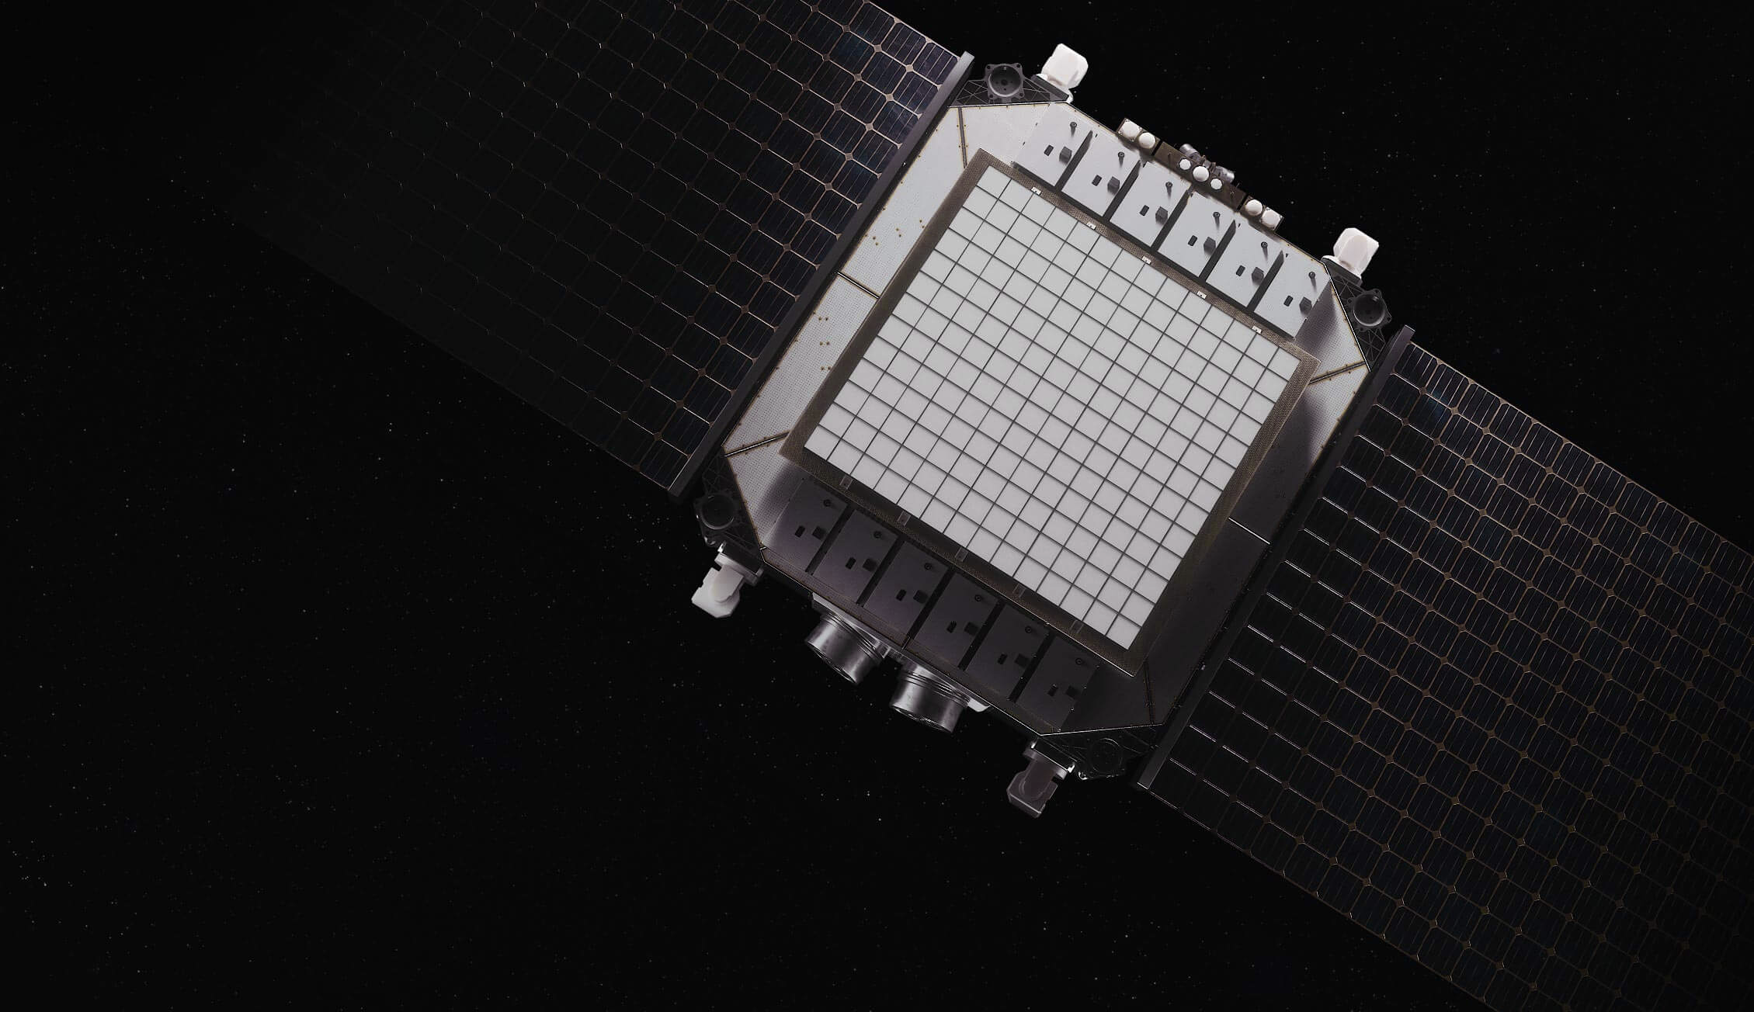




Finding technology is not the hard part.
IMAGE COURTESY OF K2 SPACE
The hard part is making it usable.
THE ABSORPTION GAP
Operational Need
Technology
Evidence
Mission Use
Notes:
Commercial technology is moving quickly.
That is good.
But speed in the technology market does not automatically create speed in the mission.
The difficult part is often the space between a promising capability and the environment where somebody needs to use it.
A prototype can work and still be difficult to integrate.
A company can be selected and still not have a transition path.
A demonstration can succeed and still have no owner on the other side.
So today I want to talk about the handoff.
I’ll use two examples from SpaceWERX.
The first starts with a future operational problem: the Adaptive and Intelligent Space Challenge.
The second looks at a commercial capability moving into an existing operational test and training environment: Slingshot’s TALOS.”

Slide 5




Innovation reduces uncertainty. Integration creates continuity.
Key questions we help answer:
    What problem matters?
    What could solve it?
    What evidence is credible?
    Who needs to own the next step?
We create momentum.
The mission owner creates continuity.
Notes:
SpaceWERX is the innovation arm of the United States Space Force.
That means our job is to help bring clarity and momentum to problems that do not fit neatly inside an existing process.
We help frame operational needs.
We connect mission owners with commercial companies and research institutions.
We create mechanisms for exploring and maturing possible solutions.
We help generate evidence for a decision.
But we are not the integration arm.
We do not own every mission system, training environment, accreditation decision, program office, or operational employment decision.
Those organizations have to be part of the pathway.
The handoff is not something that happens at the end. It has to be designed from the beginning.

Slide 6
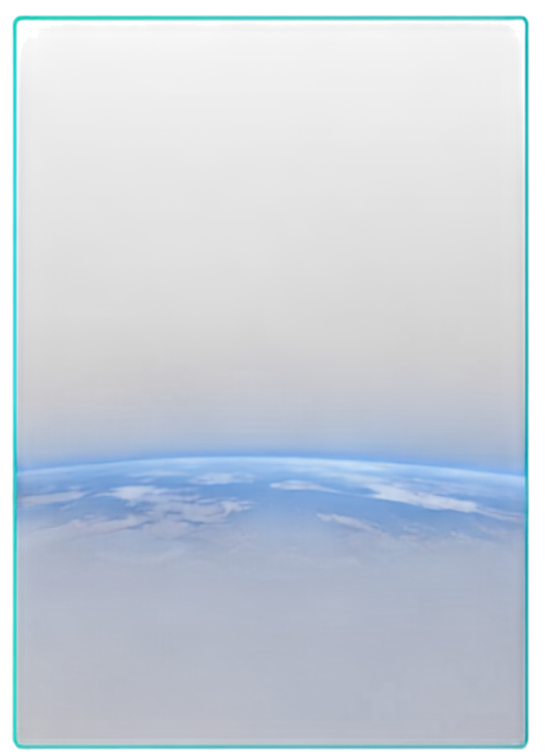


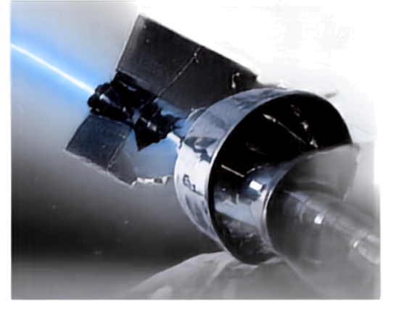

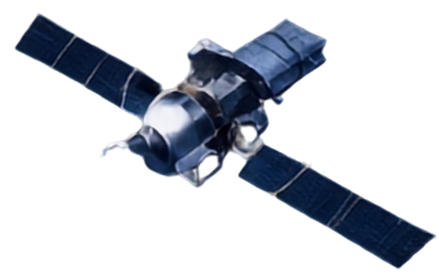
Real operating conditions. Real missions.
Missions of the future.
Proliferated LEO
RPOD and
Collision response
Cislunar operations
Some decisions may need to happen onboard and at
machine speed.
Ground systems and human operators do not scale indefinitely.
Distance and telemetry delay change what autonomy must do.
Notes:
The Adaptive and Intelligent Space Challenge begins with a future operating problem.
What happens when the scale and speed of space operations exceed what conventional ground systems and human operators can manage?
The challenge looks at proliferated LEO, rendezvous and proximity operations, collision response, and cislunar operations.
Those are not technology categories.
They are operating conditions.
It describes a space that is:
More populated
More dynamic
More contested
Less tolerant of delay
They tell us something about the kind of capability that may be needed: more autonomous, resilient, and networked systems; better onboard sensing and computing; and the ability to coordinate across missions while preserving decision advantage.
That gives industry and research institutions something more useful than a broad request for innovation.
It gives them a problem to work against.

Slide 7
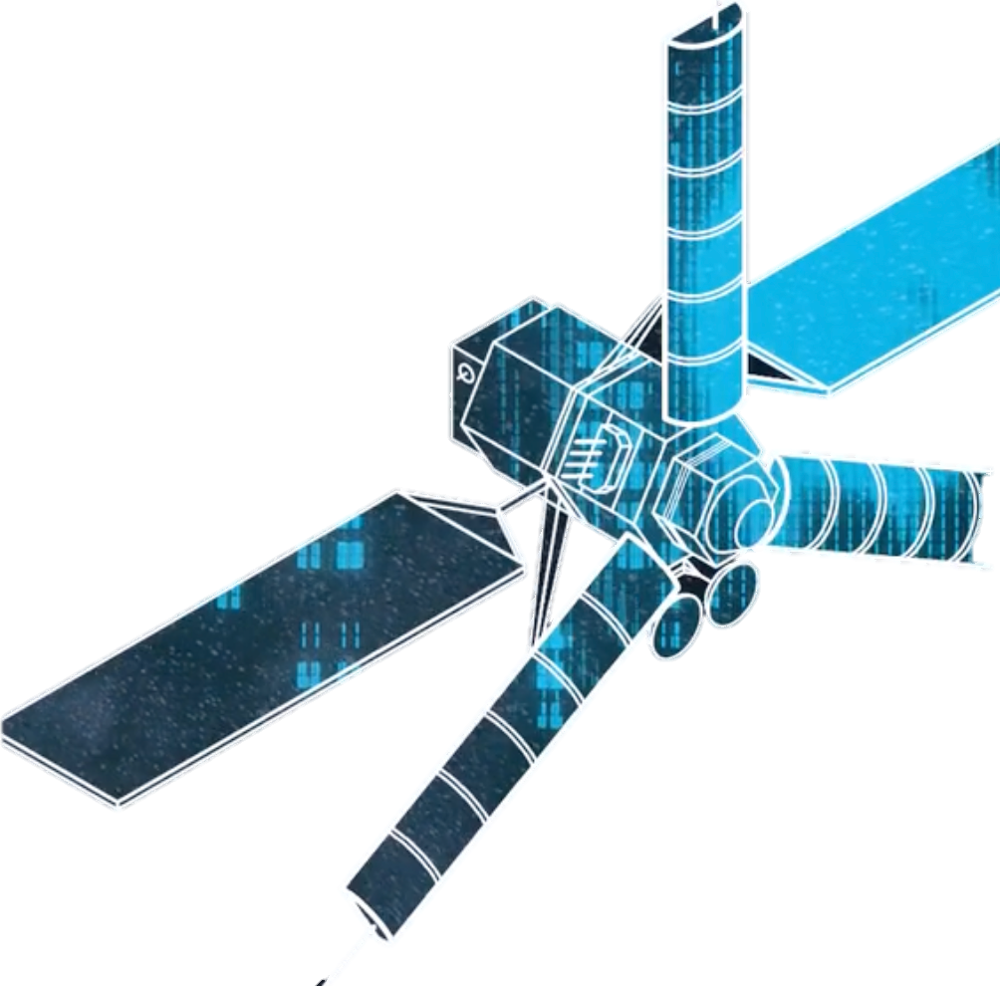



From future concept to challenge
Future Operating Concept
Mission Scenario
Technical Question
Evidence
300+
submissions
29
teams selected
5–10 year
planning horizon
Notes:
The value of a challenge is not simply the number of submissions.
The value is whether we have translated a future concept into a problem that companies and researchers can actually answer.
AIS was structured as an STTR opportunity, bringing small businesses and research institutions together.
The response was significant: more than 300 submissions, with approximately 29 teams selected to advance.
That tells us there is energy and capability in the commercial and academic ecosystem.
But selection is not transition.
Selection tells us that a proposed approach is worth examining further.
It does not yet tell us that the capability works at the relevant scale, under the relevant conditions, or inside the system where it may eventually be used.
That is the work that comes next.

Slide 8




AIS capabilities will eventually need to answer four questions
A good idea is not enough.
Mission fit
Technical behavior
Does it address a real space-control or battle-management problem?
Does it work under relevant scale, delay, threat, or autonomy conditions?
MOMENTUM
Human and system interaction
Transition ownership
Evidence supports
a decision.
Who is prepared to take the next step?
Can the people and systems involved use its outputs?
CONTINUITY
A mission owner carries
the capability forward.
SPACEWERX
EXTERNAL
Notes:
For AIS, a technical demonstration is necessary.
It is not sufficient.
We need to understand whether a capability improves a relevant mission function.
Does it help sense and understand the environment?
Does it support space control?
Does it help a commander manage dynamic space operations?
Then we need to test behavior under the conditions that motivated the challenge in the first place: scale, contested environments, communications delay, and autonomy.
And we need to understand how the capability interacts with people and systems.
Finally, there has to be ownership.
Who needs this capability?
Who will define the next experiment?
Who will integrate it?
Who will operate and sustain it?
Without those answers, a challenge can produce a very interesting collection of technologies without producing a path to mission use.

Slide 9
Transition is a shared design problem.
Innovation Arm
Enterprise Enablers
Data
Frames
Discovers
Develops
Evidence
Infrastructure
Security
Governance
Interoperability
PAEs
Defines use
Sets acceptance criteria
Integrates
Sustains
All three must be owned.
PRIORITY ZONE
The receiving organization must be involved before the handoff.
SPACEWERX
EXTERNAL
Notes:
This is the boundary I want to make clear.
SpaceWERX can help find and mature a capability.
We can help connect that capability to the people who may eventually use it.
But the receiving organization has to be involved early.
Otherwise, the innovation process may optimize for a successful demonstration that nobody is prepared to absorb.
The mission owner knows what environment matters.
The program or operational owner knows what constraints matter.
The user knows what useful looks like.
The acquisition and security communities know what has to be true for the capability to continue.
The innovation arm can help bring those voices together.
It cannot replace them

Slide 10
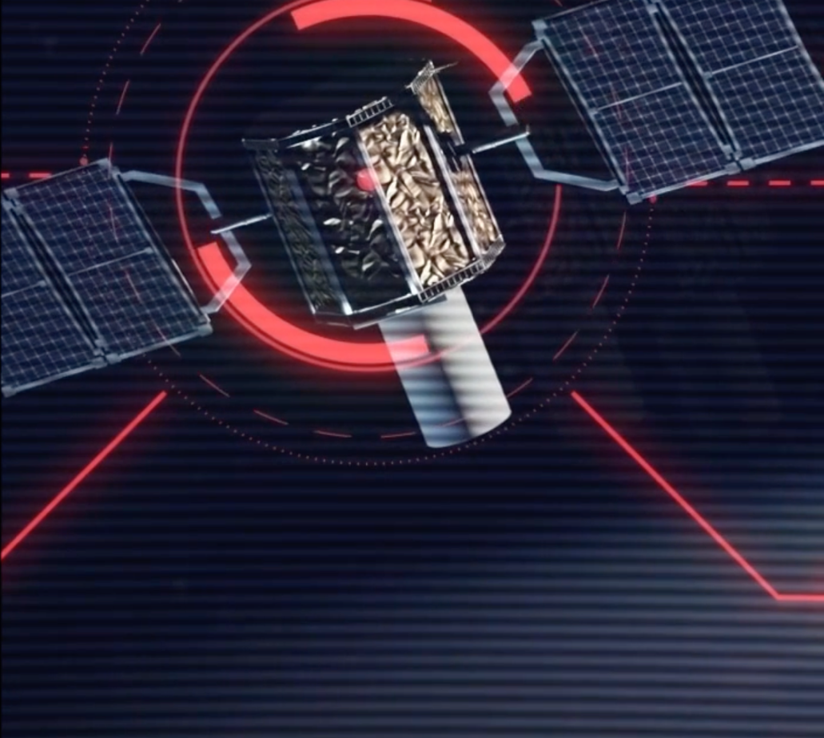

Slingshot’s TALOS
A capability enters the ecosystem.
TALOS is being integrated into the Space Force's operational test and training infrastructure to support more dynamic, realistic space warfare scenarios.
Training platforms
Data sources
Sensors and partner systems
Instructors
Operators and trainees
OTTI infrastructure
TALOS
Notes:
AIS starts with the future.
Slingshot’s TALOS gives us a different view.
Here the question is not only what a future capability might do.
The question is how a commercial AI capability enters an existing ecosystem.
TALOS is designed to model adaptive and autonomous adversary behavior in dynamic orbital environments.
That matters because a scripted opponent can only do what it was scripted to do.
A more adaptive opponent can create a training environment that responds to what the trainee does.
But the important part of this example is not simply that TALOS uses AI.
The important part is where it is going.
It is being integrated into the Space Force’s Operational Test and Training Infrastructure.
T
hat means the capability has to interact with existing platforms, data, sensors, partner systems, instructors, trainees, and training objectives.
This is what operational relevance begins to look like.

Slide 11

Integration is more than an interface.
What does “absorbable” mean?
Someone owns it after the pilot
Behavior can be tested and governed
Changes a real workflow or outcome
Connects the right systems and data
The right people use the output
IMAGE COURTESY OF SLINGSHOT
Notes:
Integration is often treated like an interface problem.
Can the system connect?
Can the data move?
Can the software run?
Those questions matter.
But they are not the whole problem.
Who uses the output?
What changes in the training or operational process?
How is model behavior evaluated?
How are updates controlled?
What happens when the model is wrong?
Who owns the capability after the original effort ends?
A capability is absorbable when the organization can continue using it responsibly.
That requires technical integration.
It also requires user ownership, governance, training, sustainment, and a decision about what happens next.

Slide 12
One model: from need to mission use
A Repeatable Path
Operational Condition
Scenarios
Commercial & Research Options
Evidence in Relevant Environment
Receiving Owner
Integration & Use
Learn and Scale
Future need → scenarios → commercial/research response
AIS
Capability → relevant environment → training ecosystem
TALOS
Notes:
These two examples sit at different points on the same path.
AIS helps us look forward.
It starts with the conditions future space operations may create and uses those conditions to shape technical and research activity.
TALOS helps us examine the receiving environment.
It shows that the capability has to function within systems, data, users, training objectives, and governance structures that already exist.
The innovation arm connects those points.
It helps the enterprise move from a problem that needs attention to evidence that supports a decision.
Then the receiving organization has to take responsibility for what comes next.

Slide 13
Three things to remember
1
Start with the operating condition.
Not the technology category.
2
Measure transition by evidence and ownership.
Not by submissions, selections, or demonstrations alone.
3
Design the handoff early.
Because innovation and integration are related—but they are not the same job.
Our challenge is no longer simply accelerating innovation.
It is building the conditions that allow the mission to absorb innovation at speed.
Notes:
If I could leave you with three ideas, they would be these.
Start with the operating condition.
Measure transition by evidence and ownership, not activity.
And design the handoff early.
SpaceWERX is not the integration arm.
Our value is helping reduce uncertainty, connect the right people, and create momentum around capabilities that may matter to the mission.
The measure of success is what happens after that.
Can the mission owner make a decision?
Can the organization absorb the capability?
Can it be trained, governed, sustained, and used?
That is where innovation becomes operational advantage.”

Slide 14

Q+A
SPACEWERX

